Slide 1
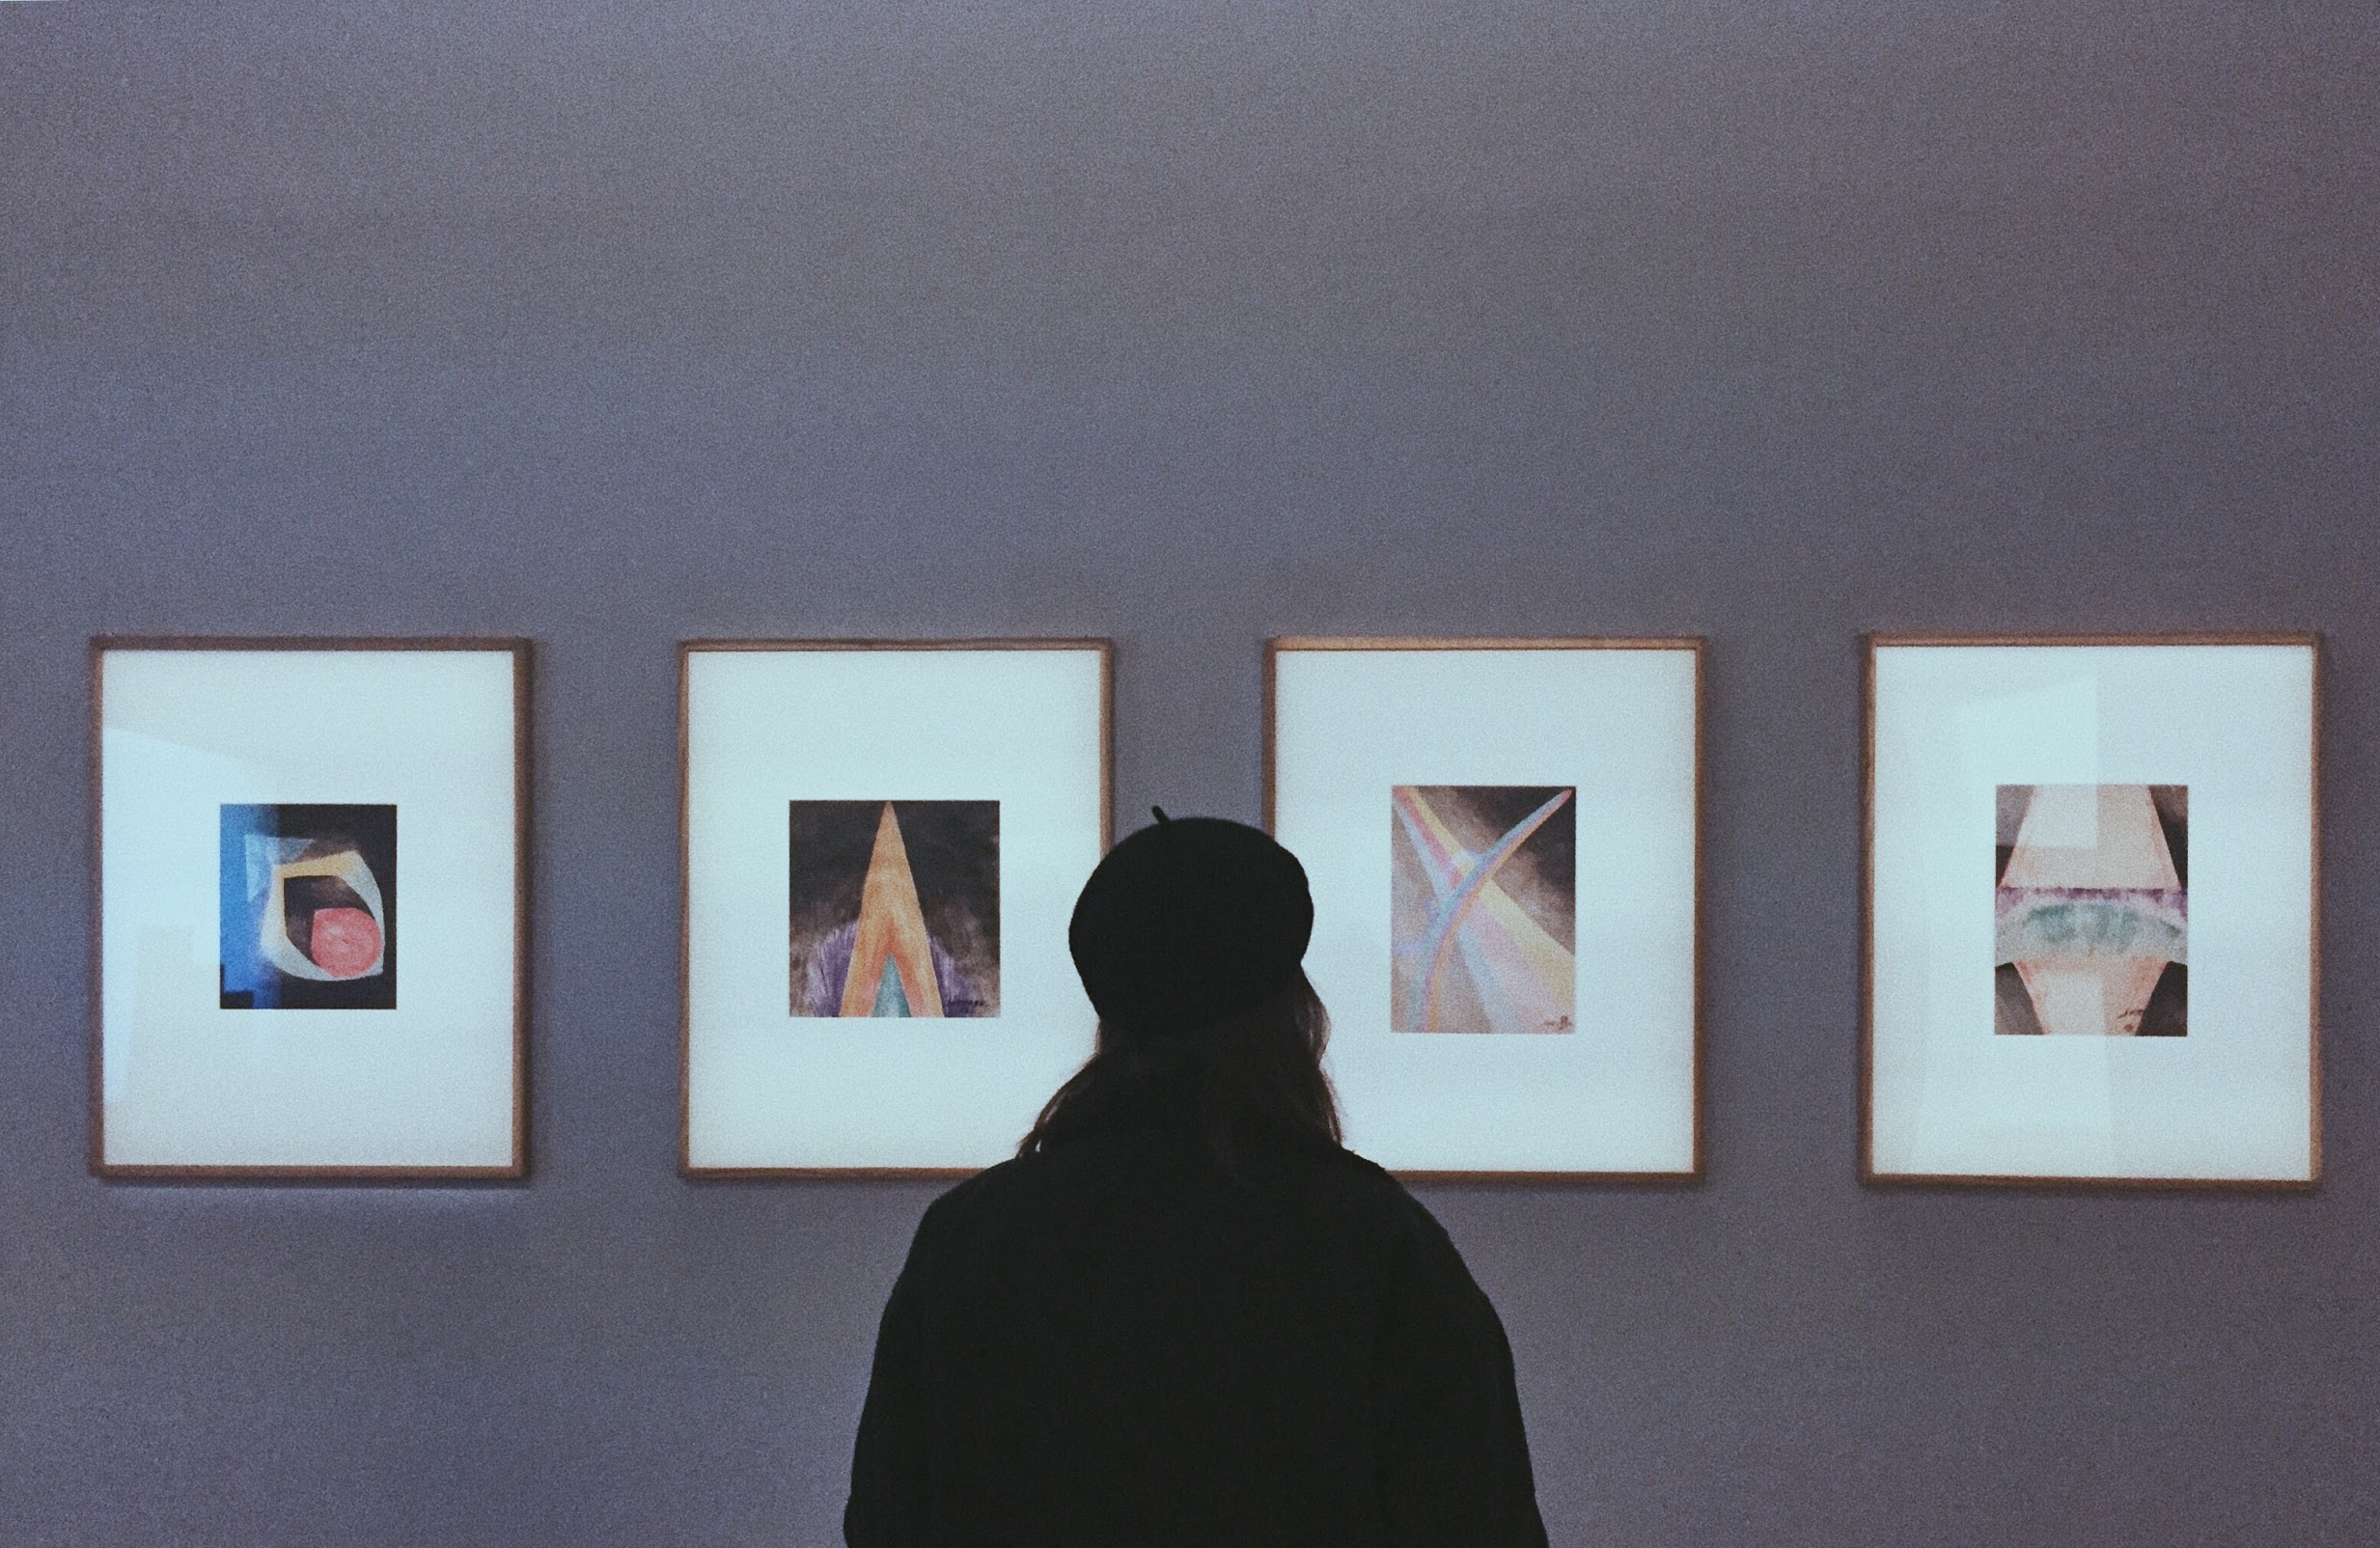
Museum Tour Guide
LT2319 - Final Project
Kate Viloria

Slide 2
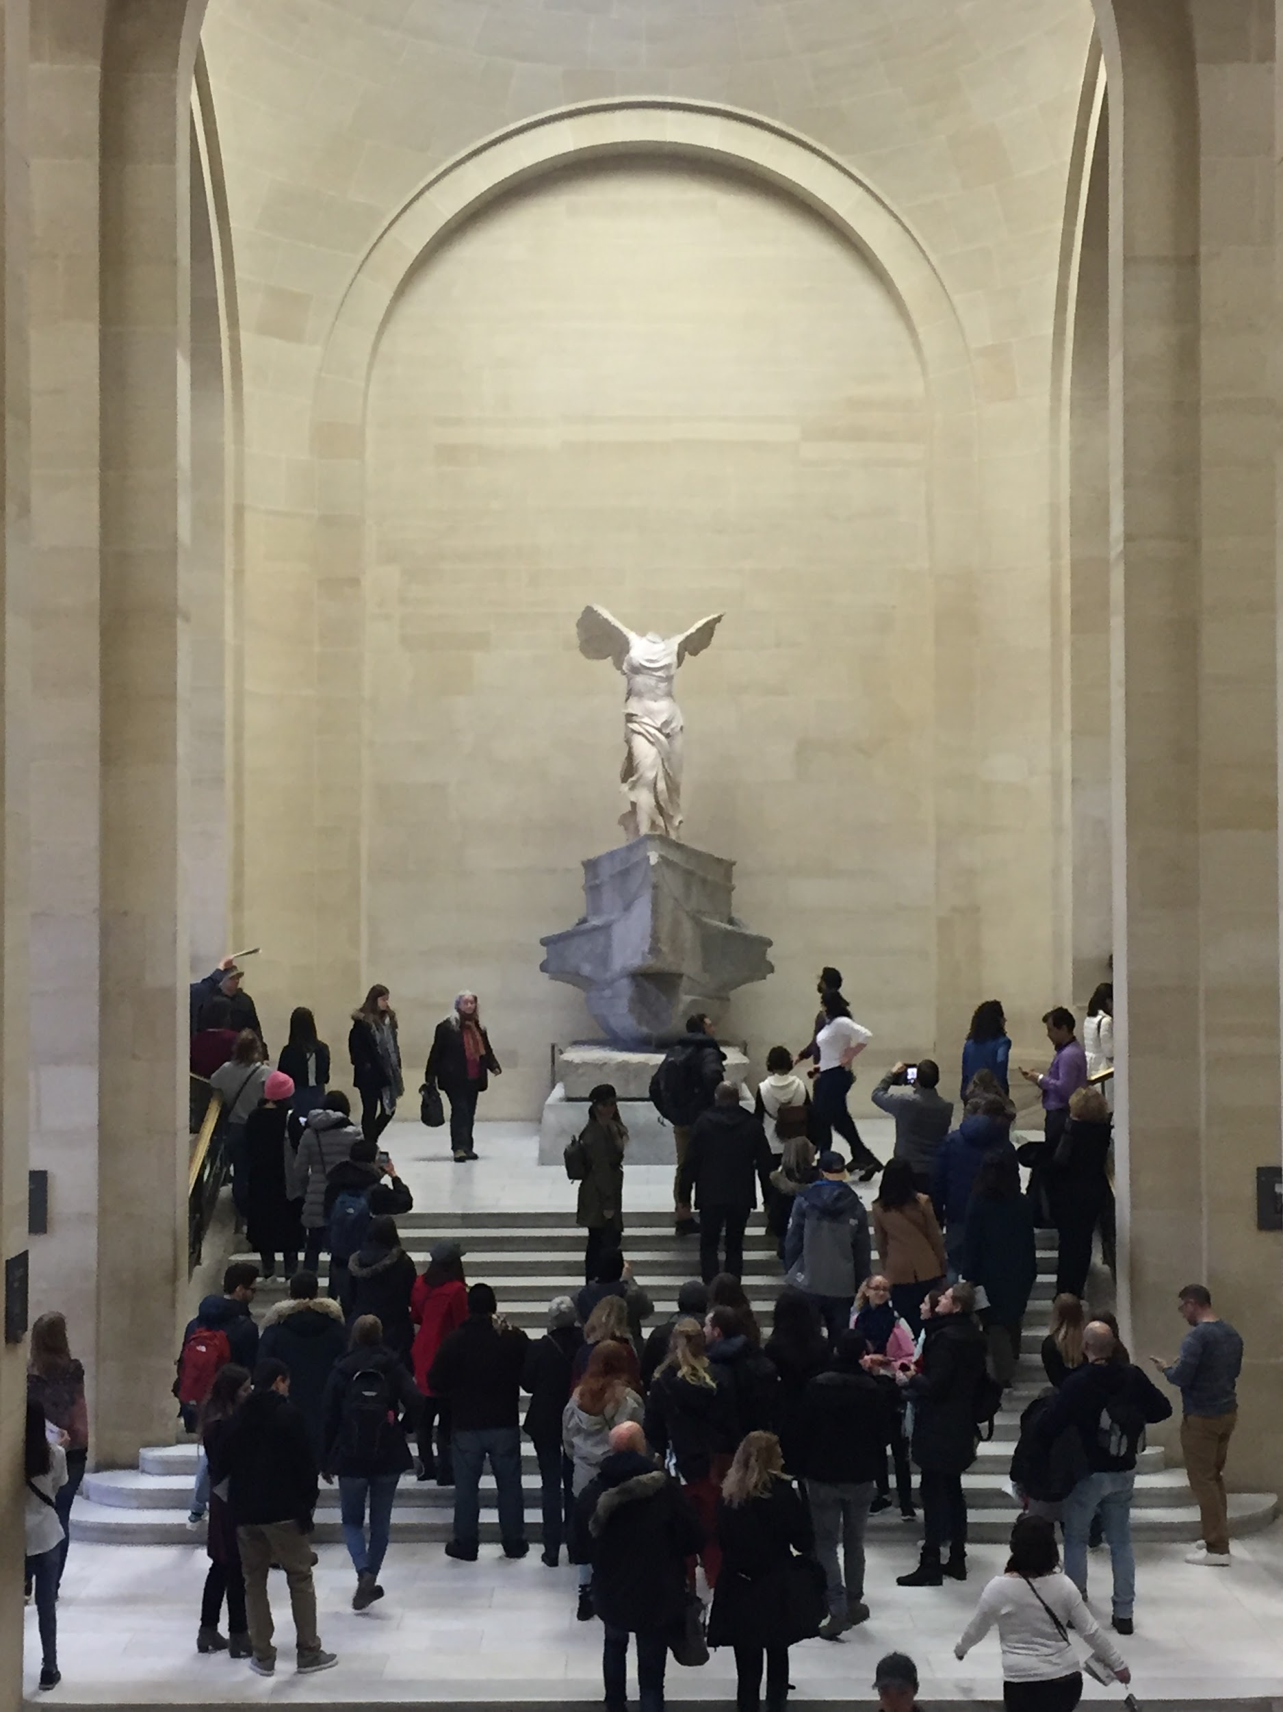

WHY
convenience
crowd control
accessibility

Slide 3

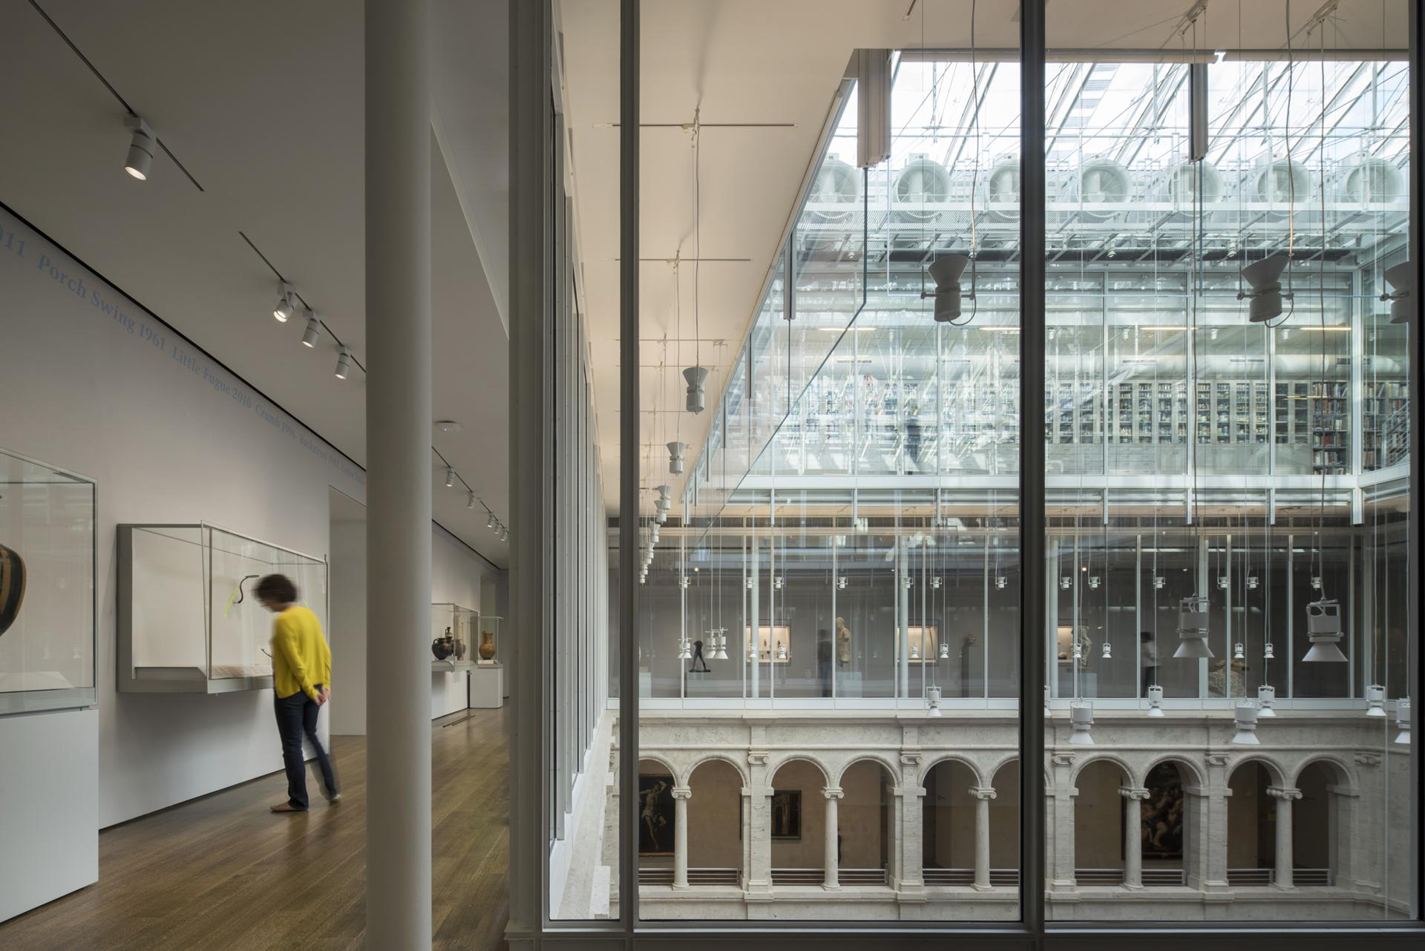

Slide 4
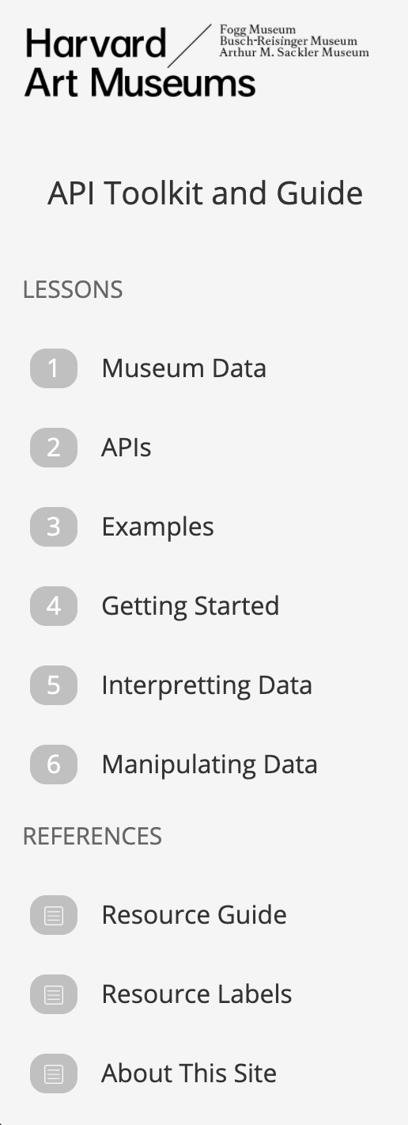

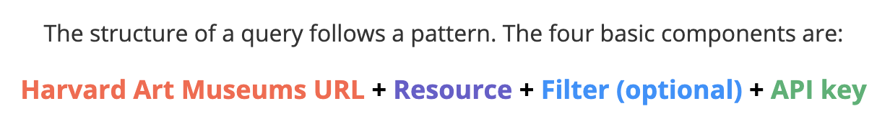
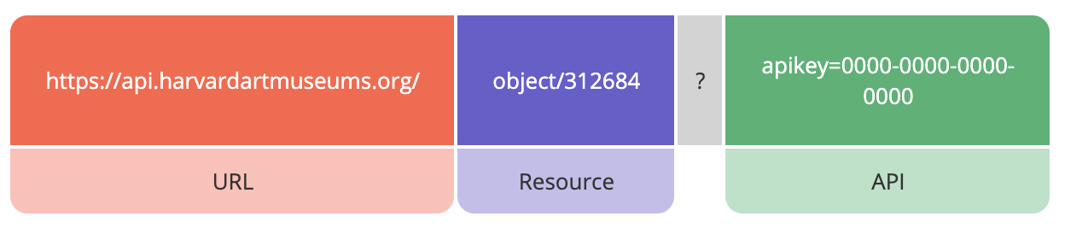
Museum Data
- entire wealth of information a museum collects and digitizes

Slide 5
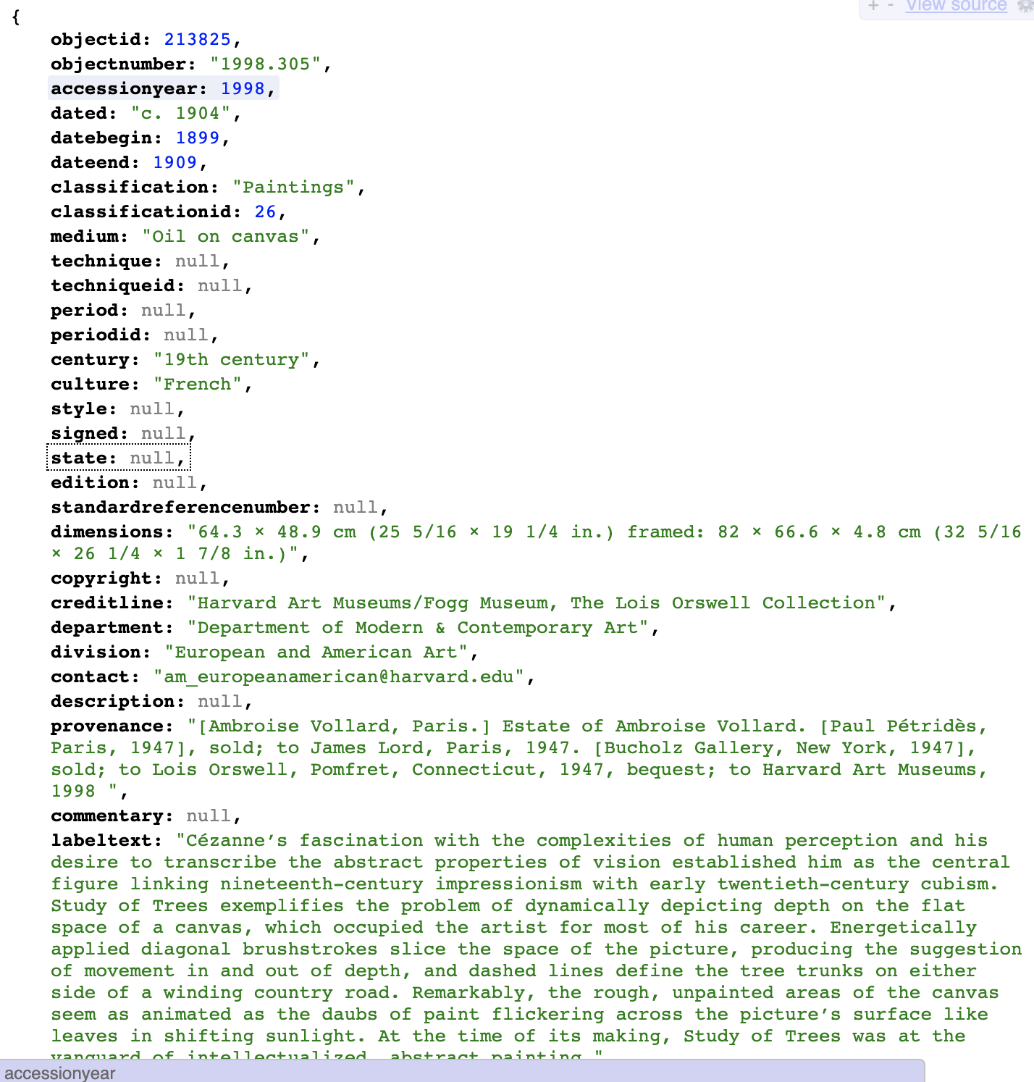
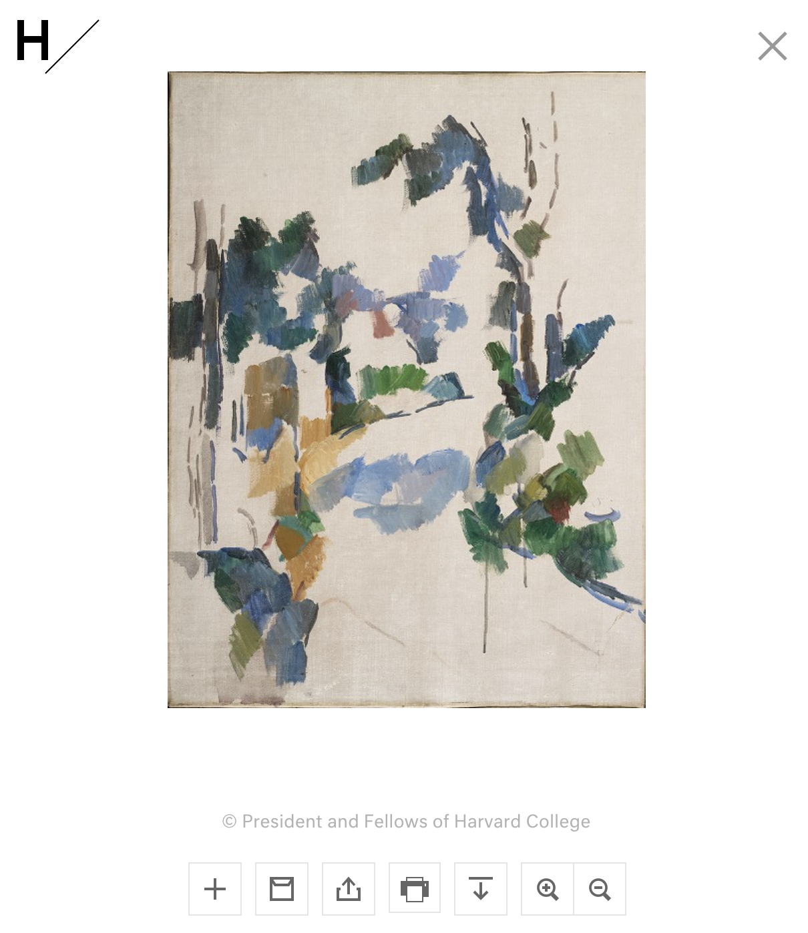
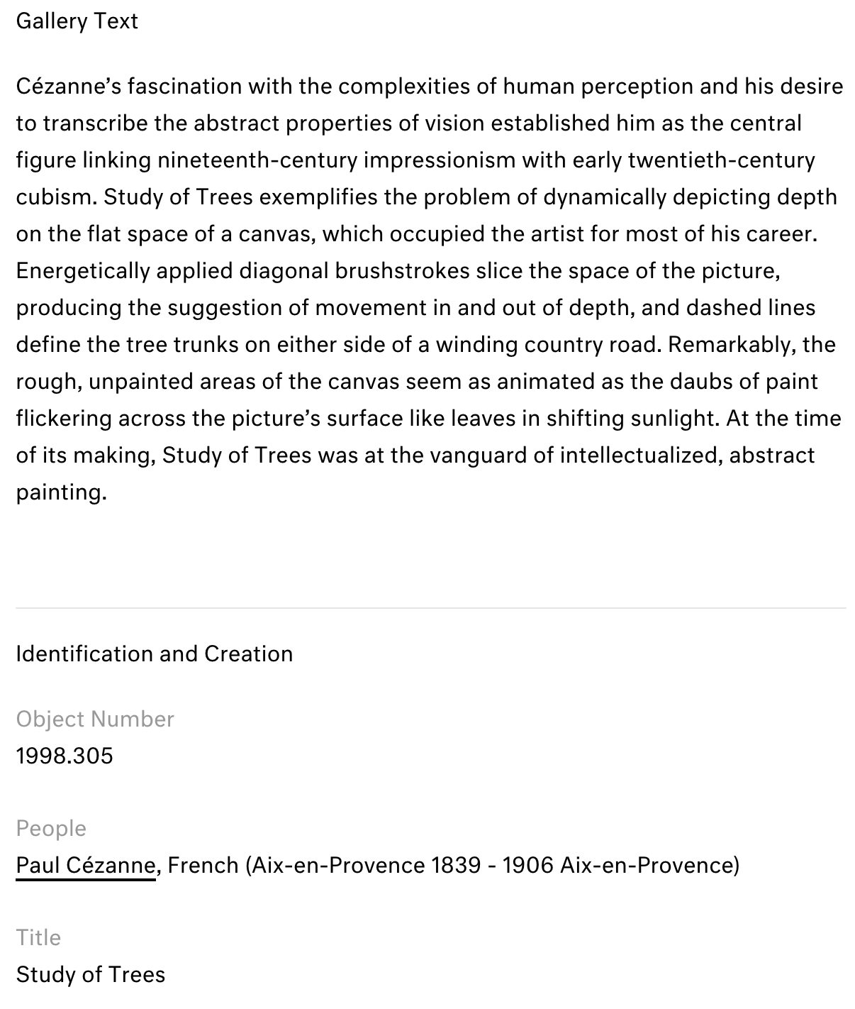
json file
website
https://www.harvardartmuseums.org/collections/object/213825?position=43
https://api.harvardartmuseums.org/object/213825?apikey=f315fe8e-b252-4a27-bdb3-0fb6dec18e67

Slide 6

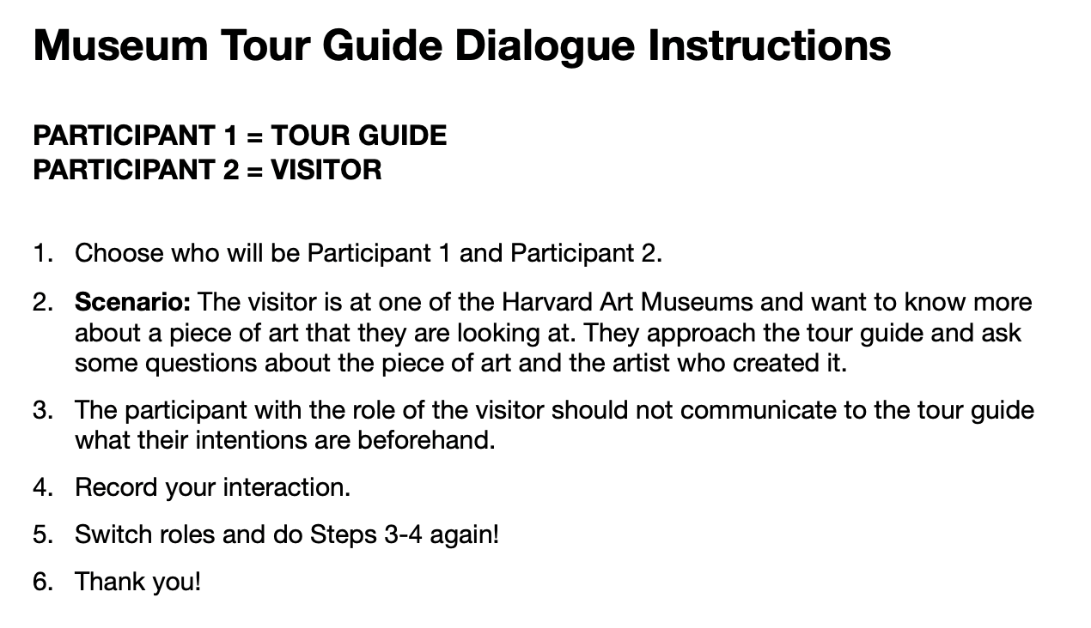
Data Collection
collected 5 dialogues
ask about any general information about a painting and artist
emphasis on seeing the painting first

Slide 7
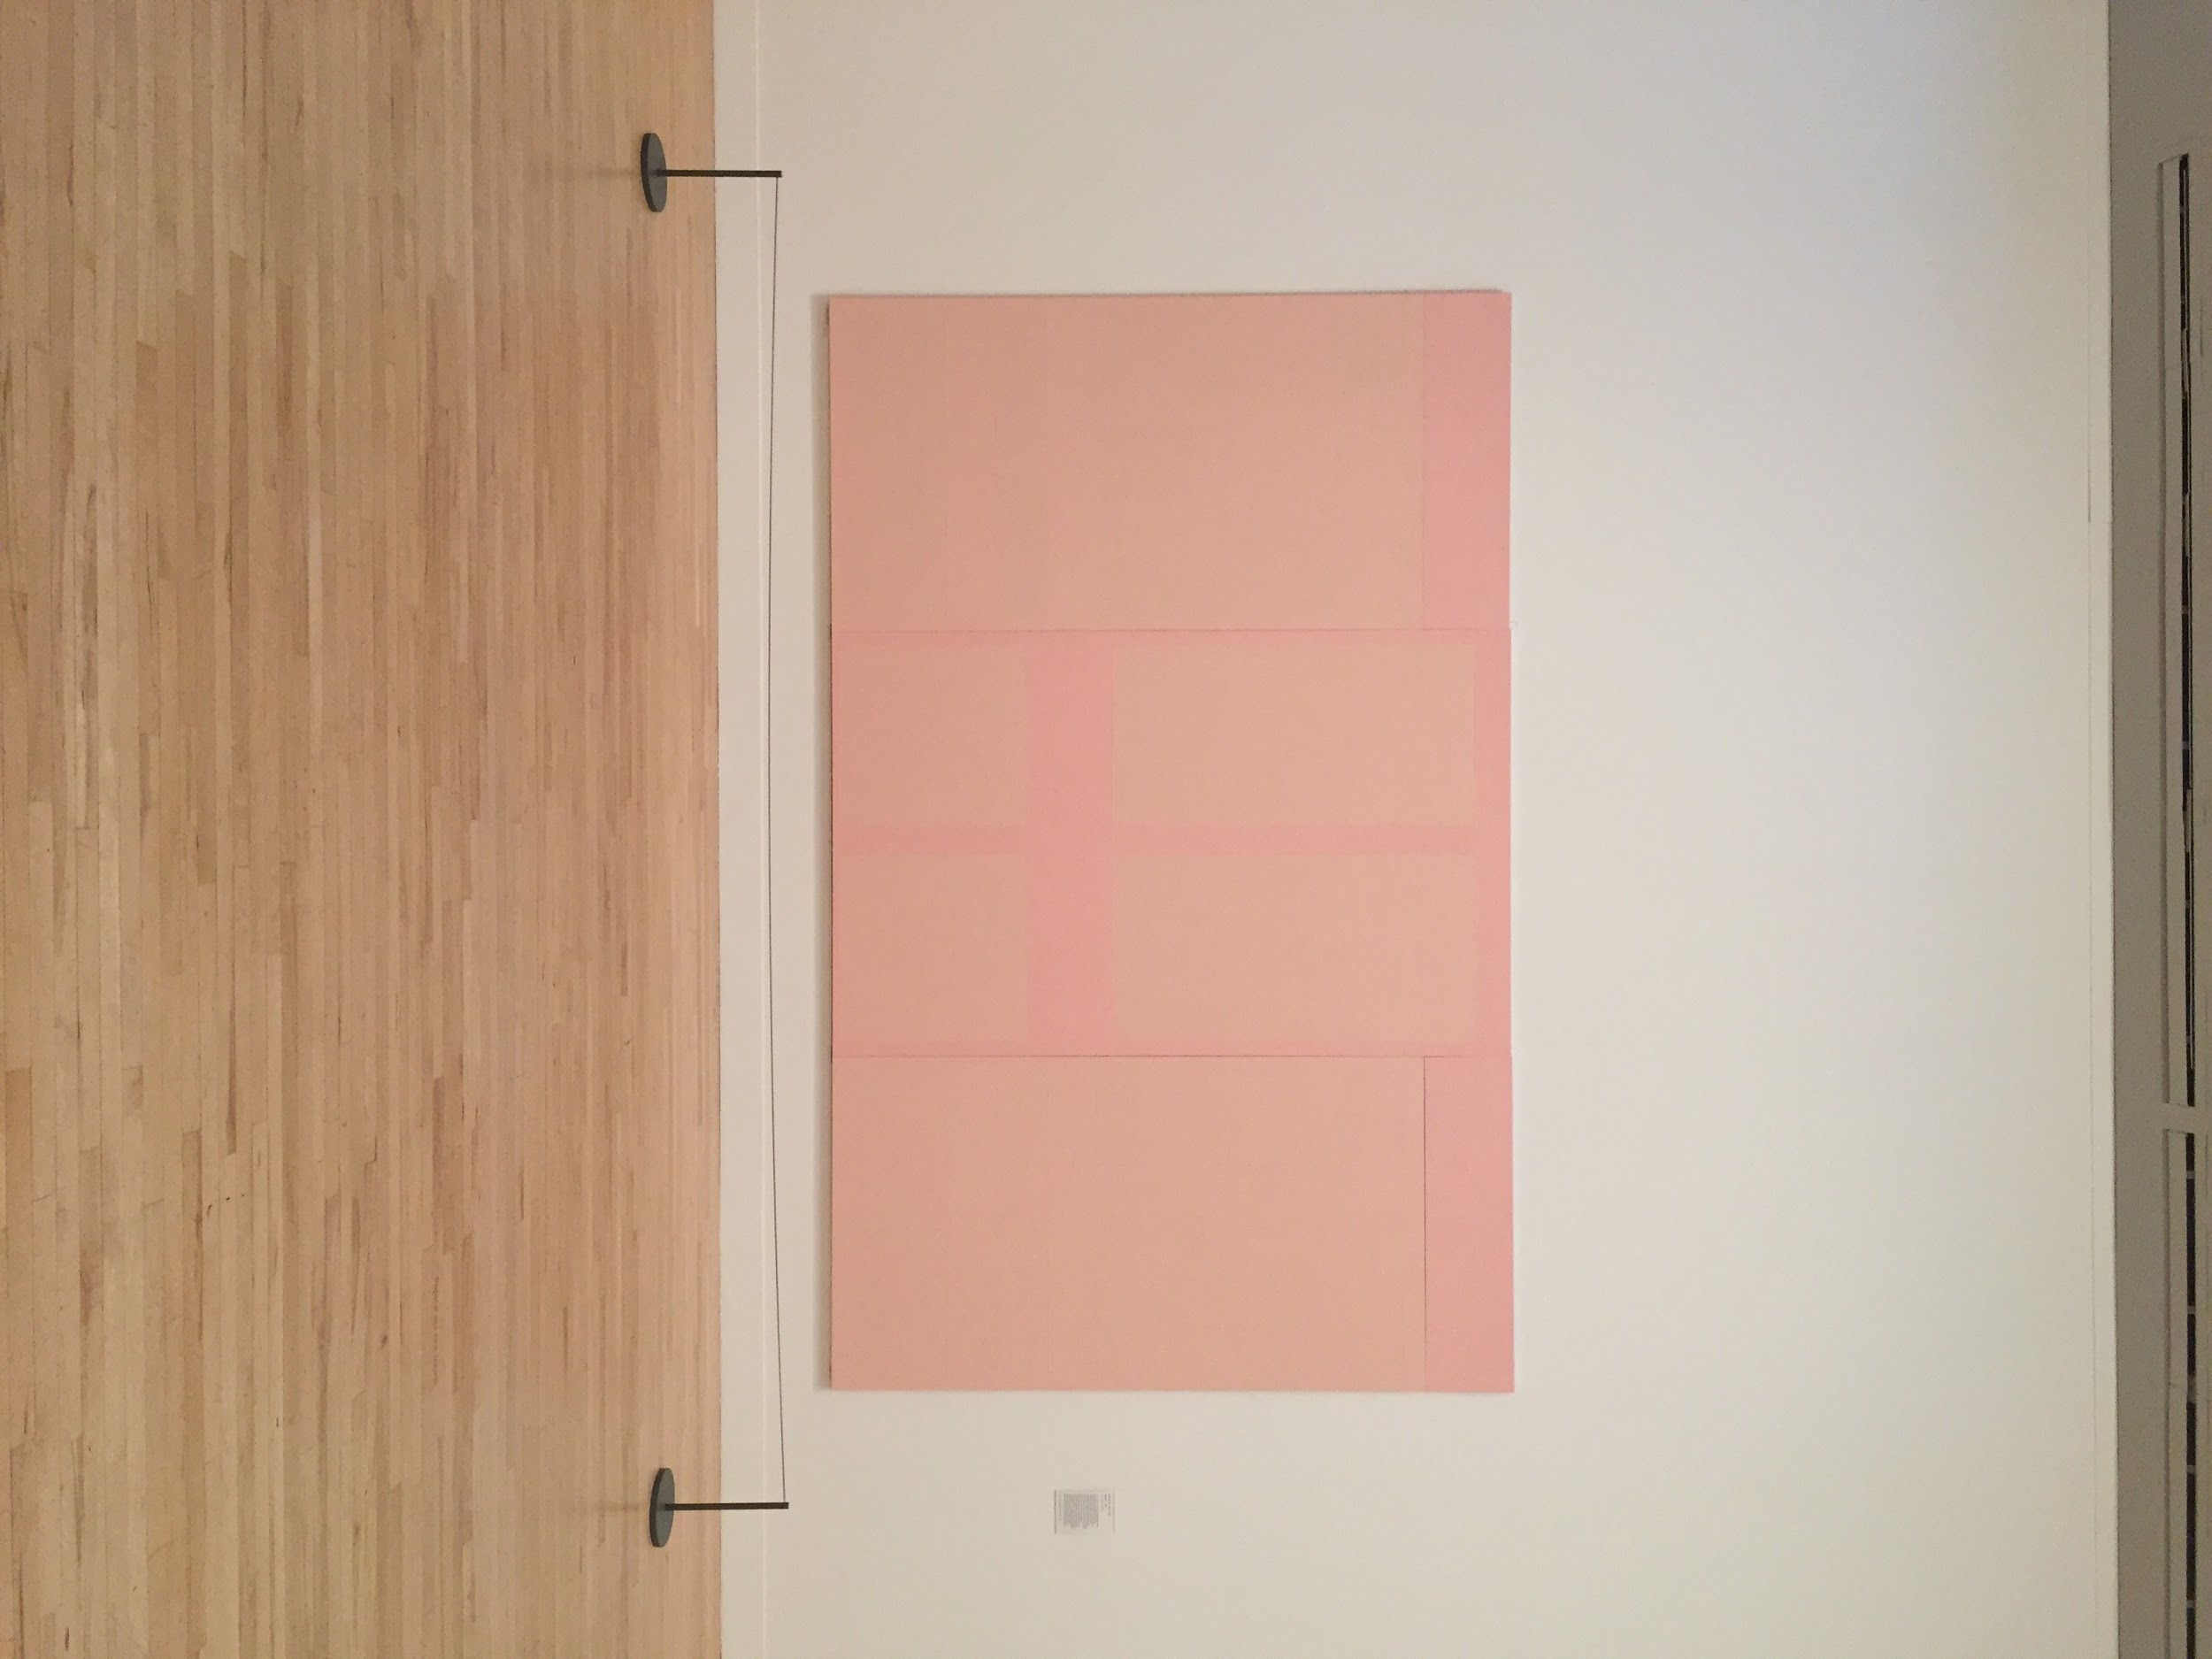
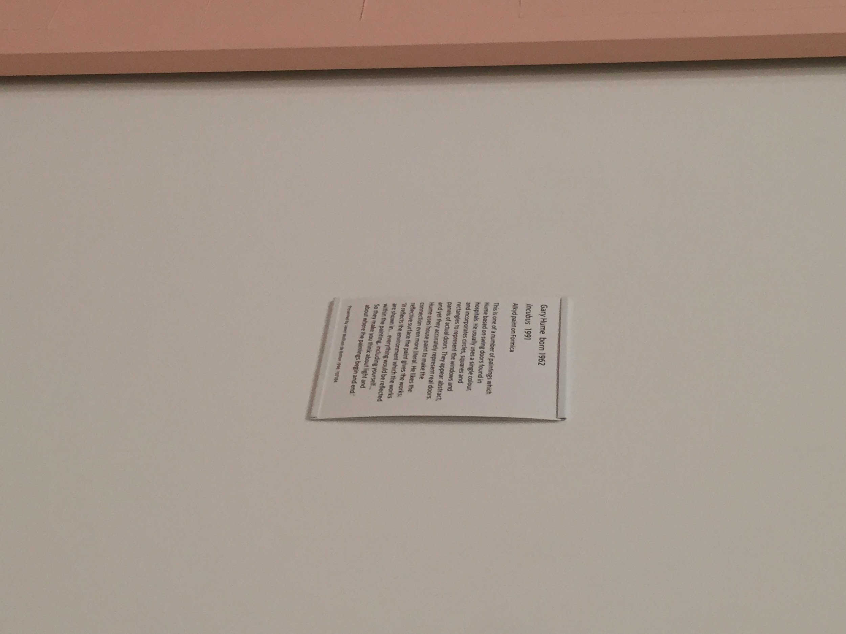
includes:
title
artist
medium
date
description and/or analysis

Slide 8
DATA SAMPLE 1
raw
→
distilled
S: Hello and welcome to Harvard Art Museum. What do you- would you- what painting would you like to know more about?
U: Um, I would like to know more about a painting called Feast of the Gods.
S: Mm. And what would you like to— know about it?
U: Uh, when was it painted?
S: Uh, it was painted- the Feast of the Gods was painted in um, 1911.
U: Oh, okay. Cool. [Um-]
S: [Is there] anything else you would like to know?
U: Yes. Uh what is the name of the artist?
S: It’s uh- the name of the artist is John.. Bellini.
U: Okay, perfect. That’s all I wanted to know.
S: Okay, have a nice day!
U: Thank you, bye.
S: Bye.
S: Hello and welcome to Harvard Art Museum. What do you- would you- [Syntax (mumbling, hesitation) → Delete] what painting would you like to know more about?
U: Um, I would like to know more about a painting called Feast of the Gods.
S: Mm. And what would you like to— [Syntax (mumbling, hesitation) → Delete] know about it.
U: Uh, when was it painted?
S: Uh, it was painted- the Feast of the Gods was painted in um, [Syntax (mumbling, hesitation) → Delete 1911.
U: Oh, okay. Cool. [Um-]
S: [Is there] anything else you would like to know?
U: Yes. Uh what is the name of the artist?
S: It’s uh- [Syntax (mumbling, hesitation) → Delete the name of the artist is John.. [Immediacy →Delete]Bellini.
U: Okay, perfect. That’s all I wanted to know.
S: Okay, have a nice day!
U: Thank you, bye.
S: Bye.
S: Hello and welcome to Harvard Art Museum. What painting would you like to know more about?
U: Um, I would like to know more about a painting called Feast of the Gods.
S: And what would you like to know about it?
U: Uh, when was it painted?
S: The Feast of the Gods was painted in 1911.
U: Oh, okay. Cool. Um-
S: Is there anything else you would like to know?
U: Yes. Uh what is the name of the artist?
S: The name of the artist is John Bellini.
U: Okay, perfect. That’s all I wanted to know.
S: Okay, have a nice day!
U: Thank you, bye.
S: Bye.

Slide 9
dialogue moves
dialogue features
S: <greet> Hello and welcome to Harvard Art Museum. </greet> <ask:painting-for-info> What painting would you like to know more about? </ask>
U: <ans:painting-for-info> Um, I would like to know more about a painting called Feast of the Gods. </ans>
S: <ask:what-info> And what would you like to know about it? </ask>
U: <ask:when> Uh, when was it painted? </ask>
S: <ans:when> The Feast of the Gods was painted in 1911. </ans>
U: <feedback:pos> Oh, okay. Cool. </feedback> [Um-]
S: <ask:anything-else> [Is there] anything else you would like to know? </ask>
U: <feedback:pos> Yes. </feedback> Uh <ask:artist> what is the name of the artist? </ask>
S: <ans:artist> The name of the artist is John Bellini. </ans>
U: <feedback:pos> Okay, perfect. </feedback> <inform:thats-all>That’s all I wanted to know. </inform>
S: <feedback:pos> Okay, </feedback> <nicety> have a nice day! </nicety>
U: <thank> Thank you, </thank> <goodbye> bye. <goodbye>
S: <goodbye> Bye. </goodbye>
straight-forward

Slide 10
DATA SAMPLE 2
raw
→
distilled
U: Hi, uh when uh was uh The Suffering uh painted?
S: It was painted in 18— 1873.
U: Mm. Who painted it?
S: Uh, George Michael.
U: Can I see a picture on my phone?
S: Sure, I’m sending a link now.
U: Thank you, uh last uh what was the birthplace of George Michael?
S: Vienna.
U: Mm.
S: Austria.
U: Okay.
U: Hi, uh when uh was uh The Suffering uh painted?
S: It was painted in 18—[Syntax (mumbling, hesitation) → Delete] 1873.
U: Mm. Who painted it?
S: Uh, [Syntax (mumbling, hesitation) → Delete] George Michael.
U: Can I see a picture on my phone?
S: Sure, I’m sending a link now.
U: Thank you, uh last uh what was the birthplace of George Michael?
S: Vienna. [long pause between Vienna and Austria, should be said all in one go]
U: Mm.
S: Austria.
U: Okay.
U: Hi, uh when uh was uh The Suffering uh painted?
S: It was painted in 1873.
U: Mm. Who painted it?
S: George Michael.
U: Can I see a picture on my phone?
S: Sure, I’m sending a link now.
U: Thank you, uh last uh what was the birthplace of George Michael?
S: Vienna, Austria
U: Mm, okay.

Slide 11
dialogue moves
dialogue features
U: <greet> Hi, : </greet> uh <ask:when> when uh was uh The Suffering uh painted? </ask>
S: <ans:when> It was painted in 1873. </ans>
U: <feedback:pos> Mm. </feedback> <ask:artist> Who painted it? </ask>
S: <ans:artist> George Michael. </ans>
U: <ask:image> Can I see a picture on my phone? </askt>
S: <feedback:pos> Sure, </feedback> <inform:send-image> I’m sending a link now. </inform>
U: <thank> Thank you, </thank> uh last uh <ask:birthplace> what was the birthplace of George Michael? </ask>
S: <ans:birthplace> Vienna, Austria </ans>
U: <feedback:pos> Mm, okay. </feedback>
- one-shot request (asks for date painting was made then provides painting to search)
- knowledge precondition question (asks if they can see picture on their phone, really asking to be sent an image to phone

Slide 12

Findings
my friends don’t really socialize with tour guides
straight-forward dialogues
mostly over-answer or one-shot request
question and answer
items for grammar entries

Slide 13

Implementation
Ontology
NEED: painting title
QUERY:
- artist
- date
- medium
- genre
- label text
- provenance
- visual description
- commentary
- image URL
- birthplace
- nationality
- lifespan
Domain
- resolve service query
Http-Service.Py
- urllib (Request)
- function for each type of query
Query Function:
- access through dictionary indexing
- if statement for null values (“unknown” or “unavailable”)
- had to remove double quotation marks in commentary
Grammar
- objectID for individuals (paintings)
- alternative titles
- tala interact
- predicate for image URL from sort image to sort string

Slide 14

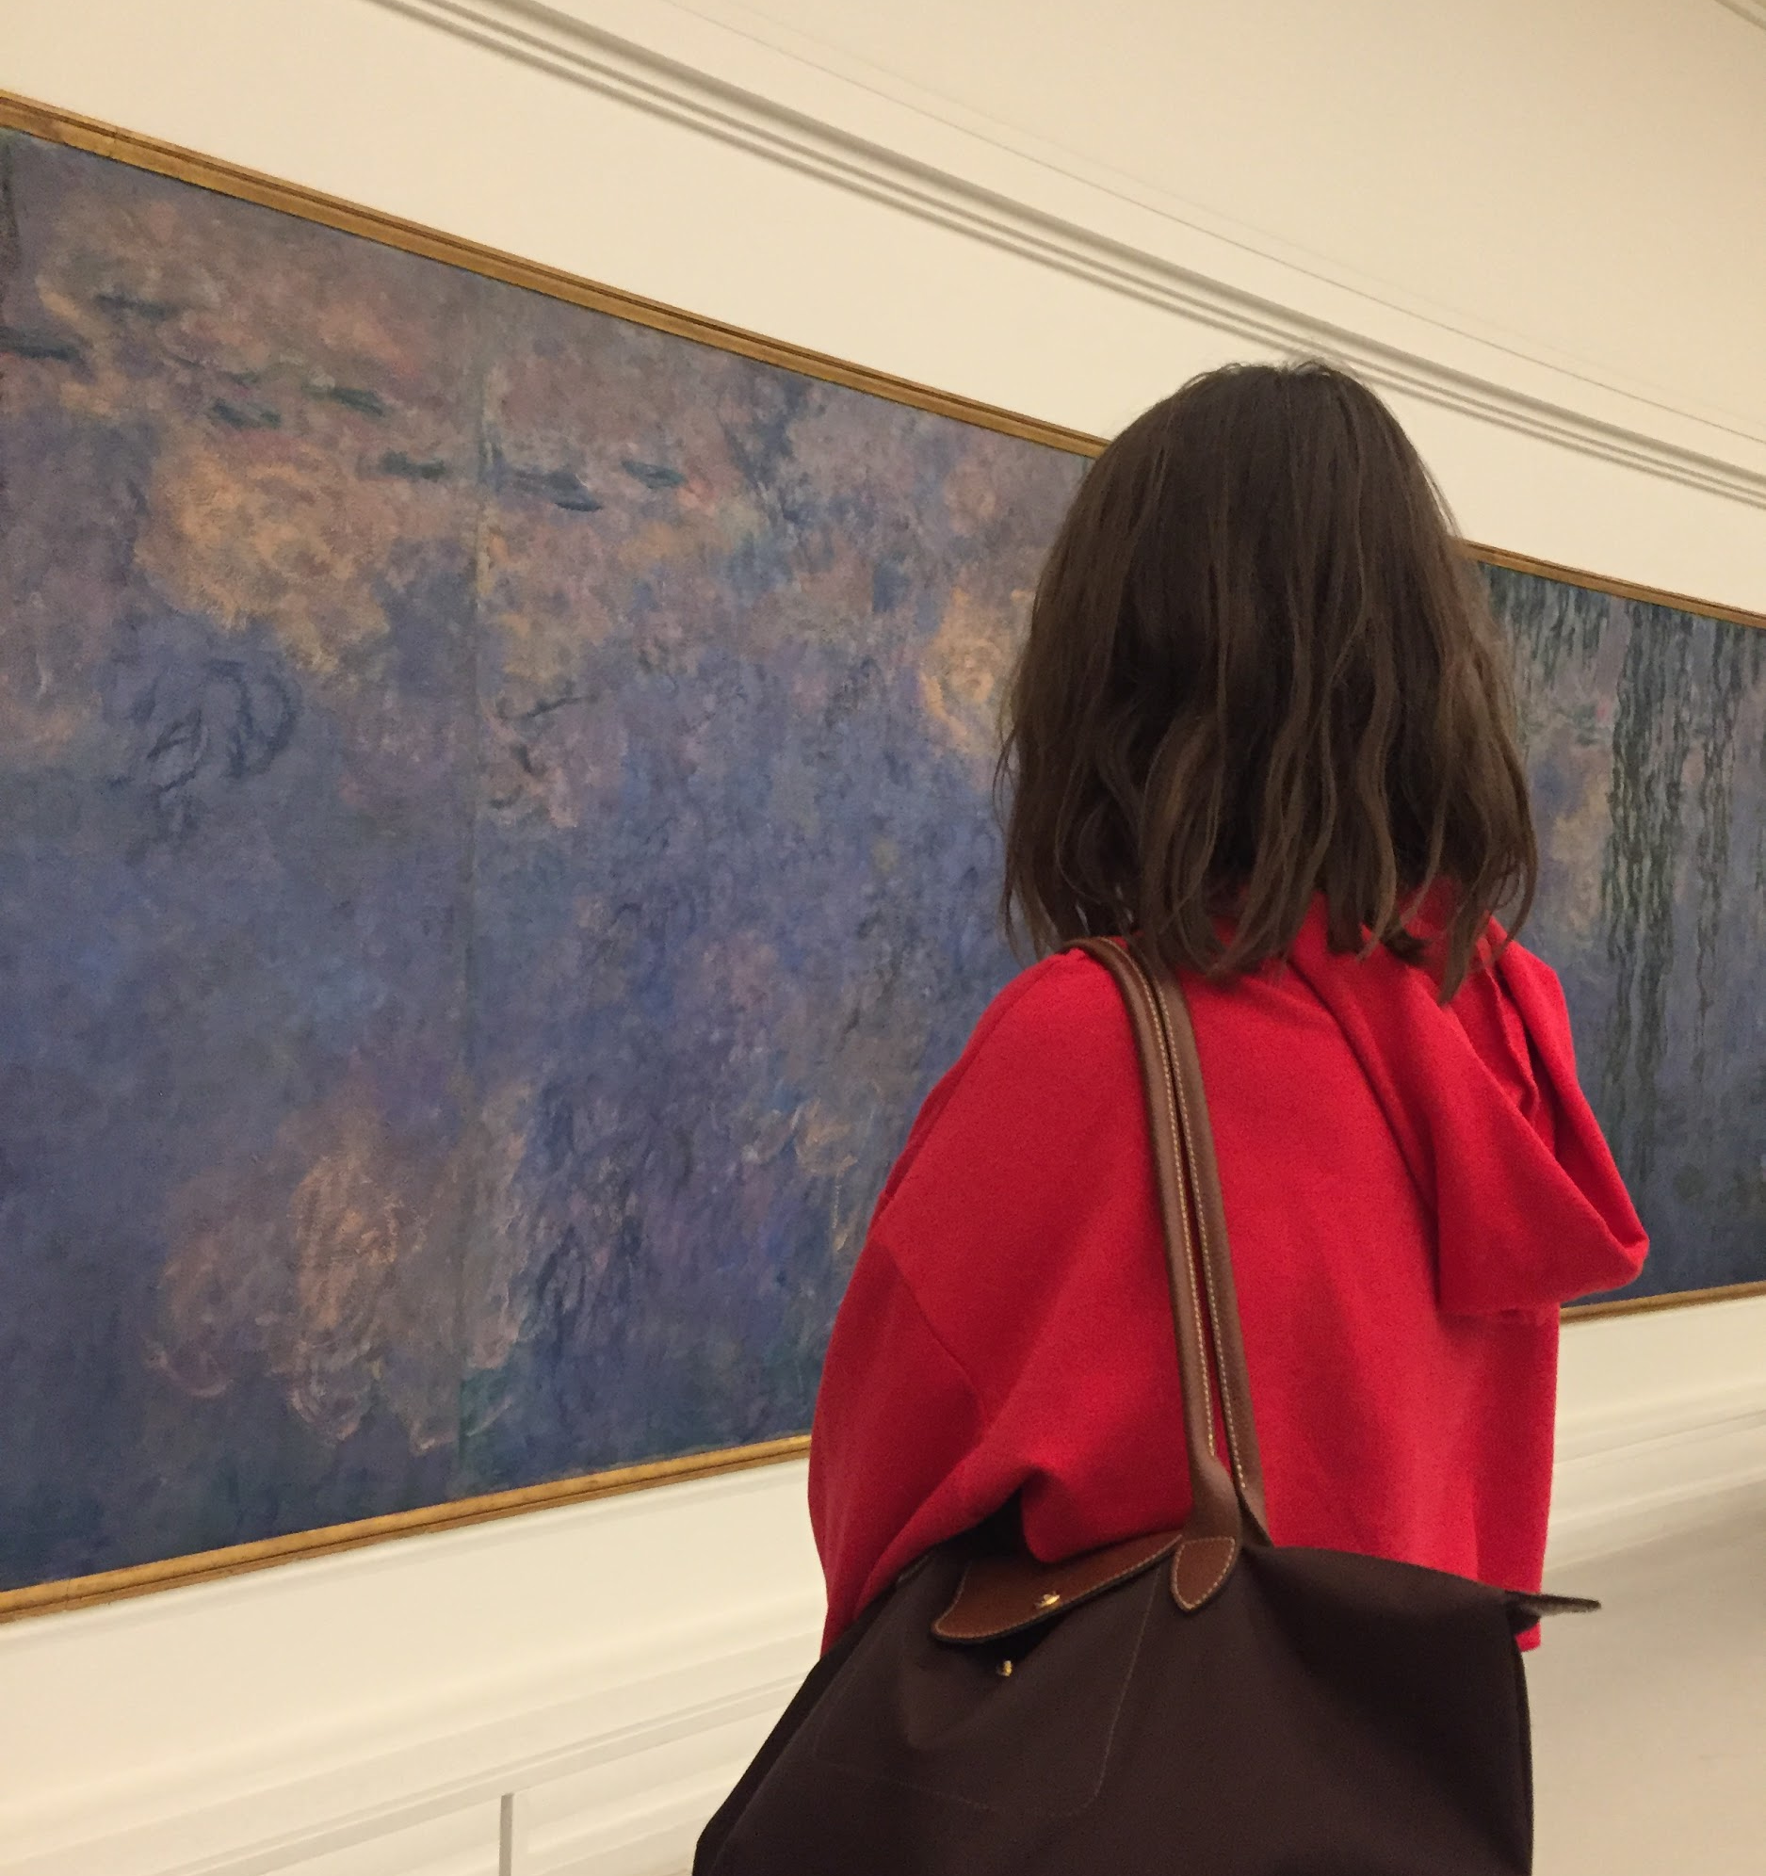
Sample Dialogues
U> I want to know the artist of the painting the water lilies the clouds.
S> The artist’s name is Claude Monet.
U> What is the medium of this painting?
S> The medium is oil on canvas.
U> Where were they born?
S> The artist was born in Paris, France.
U> I want to know when a painting was made.
S> What is the title of the painting?
U> The water lilies the clouds.
S> This painting was made in 1926
U> How long did its artist live?
S> The artist lived from 1840-1926.

Slide 15

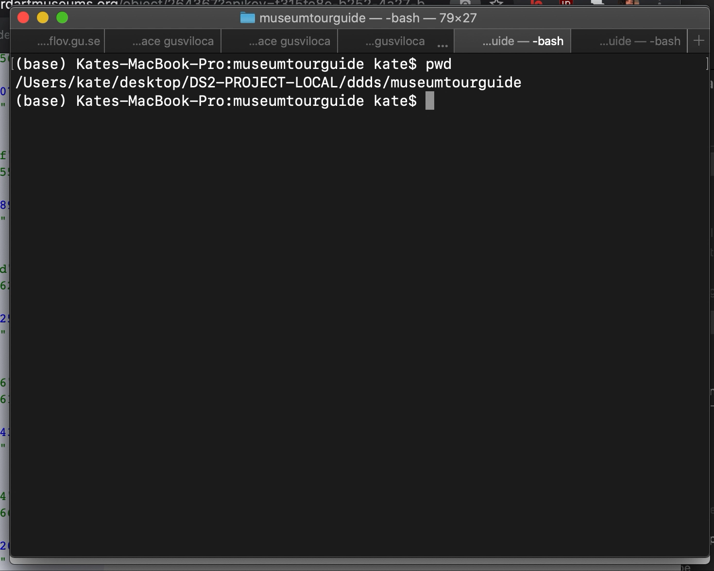
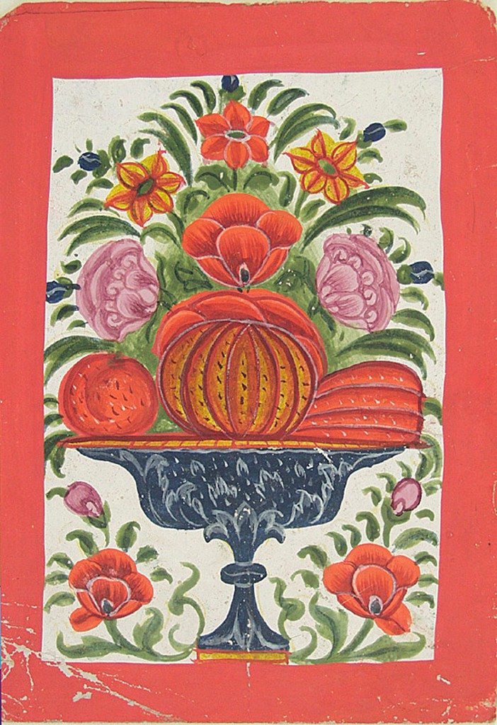
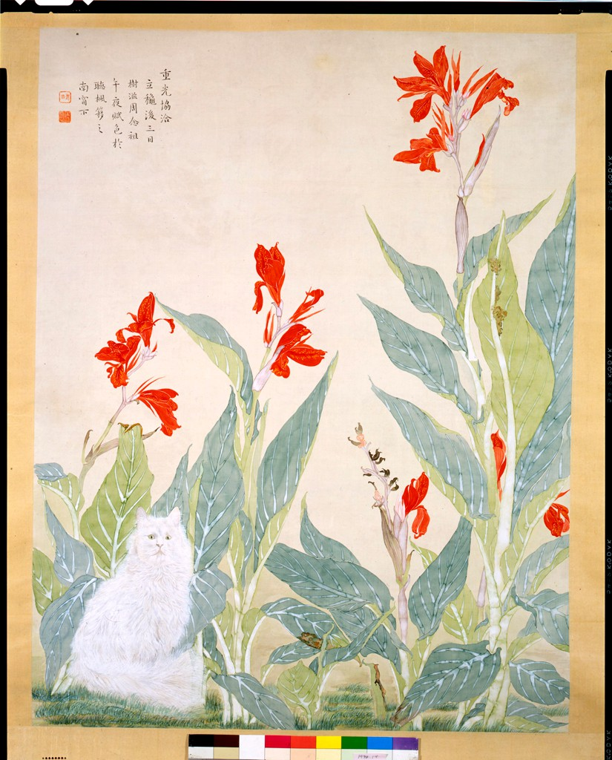
Demo 1
flowers and fruit in a blue tazza
white cat and red flowers

Slide 16
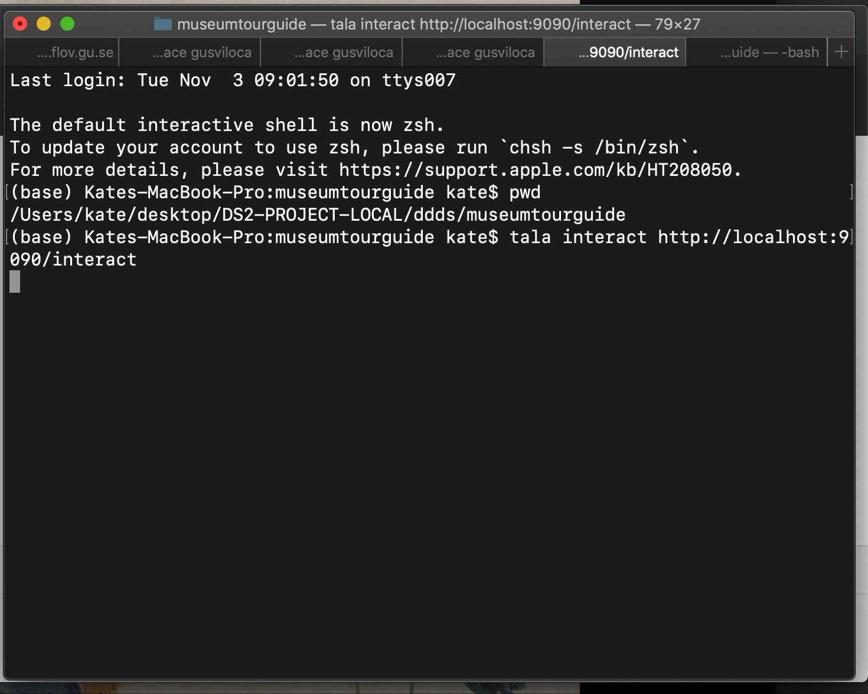
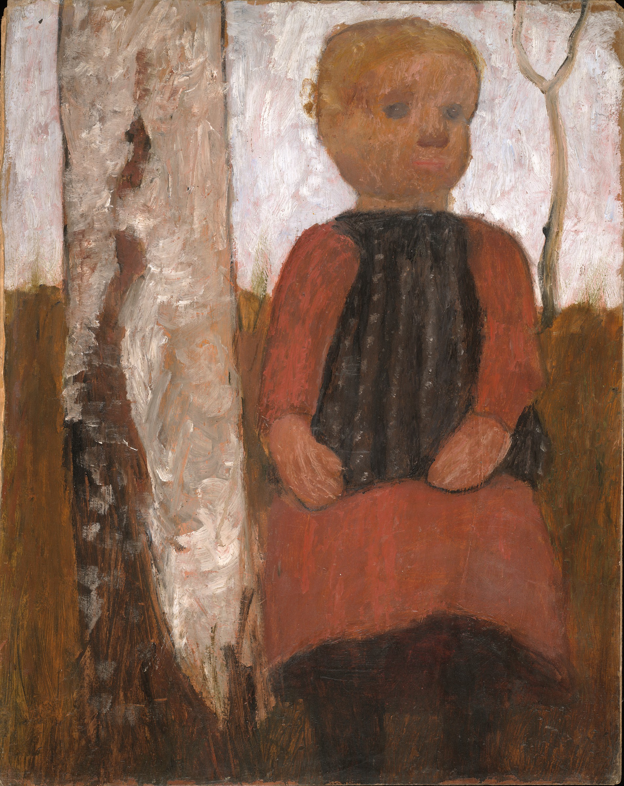
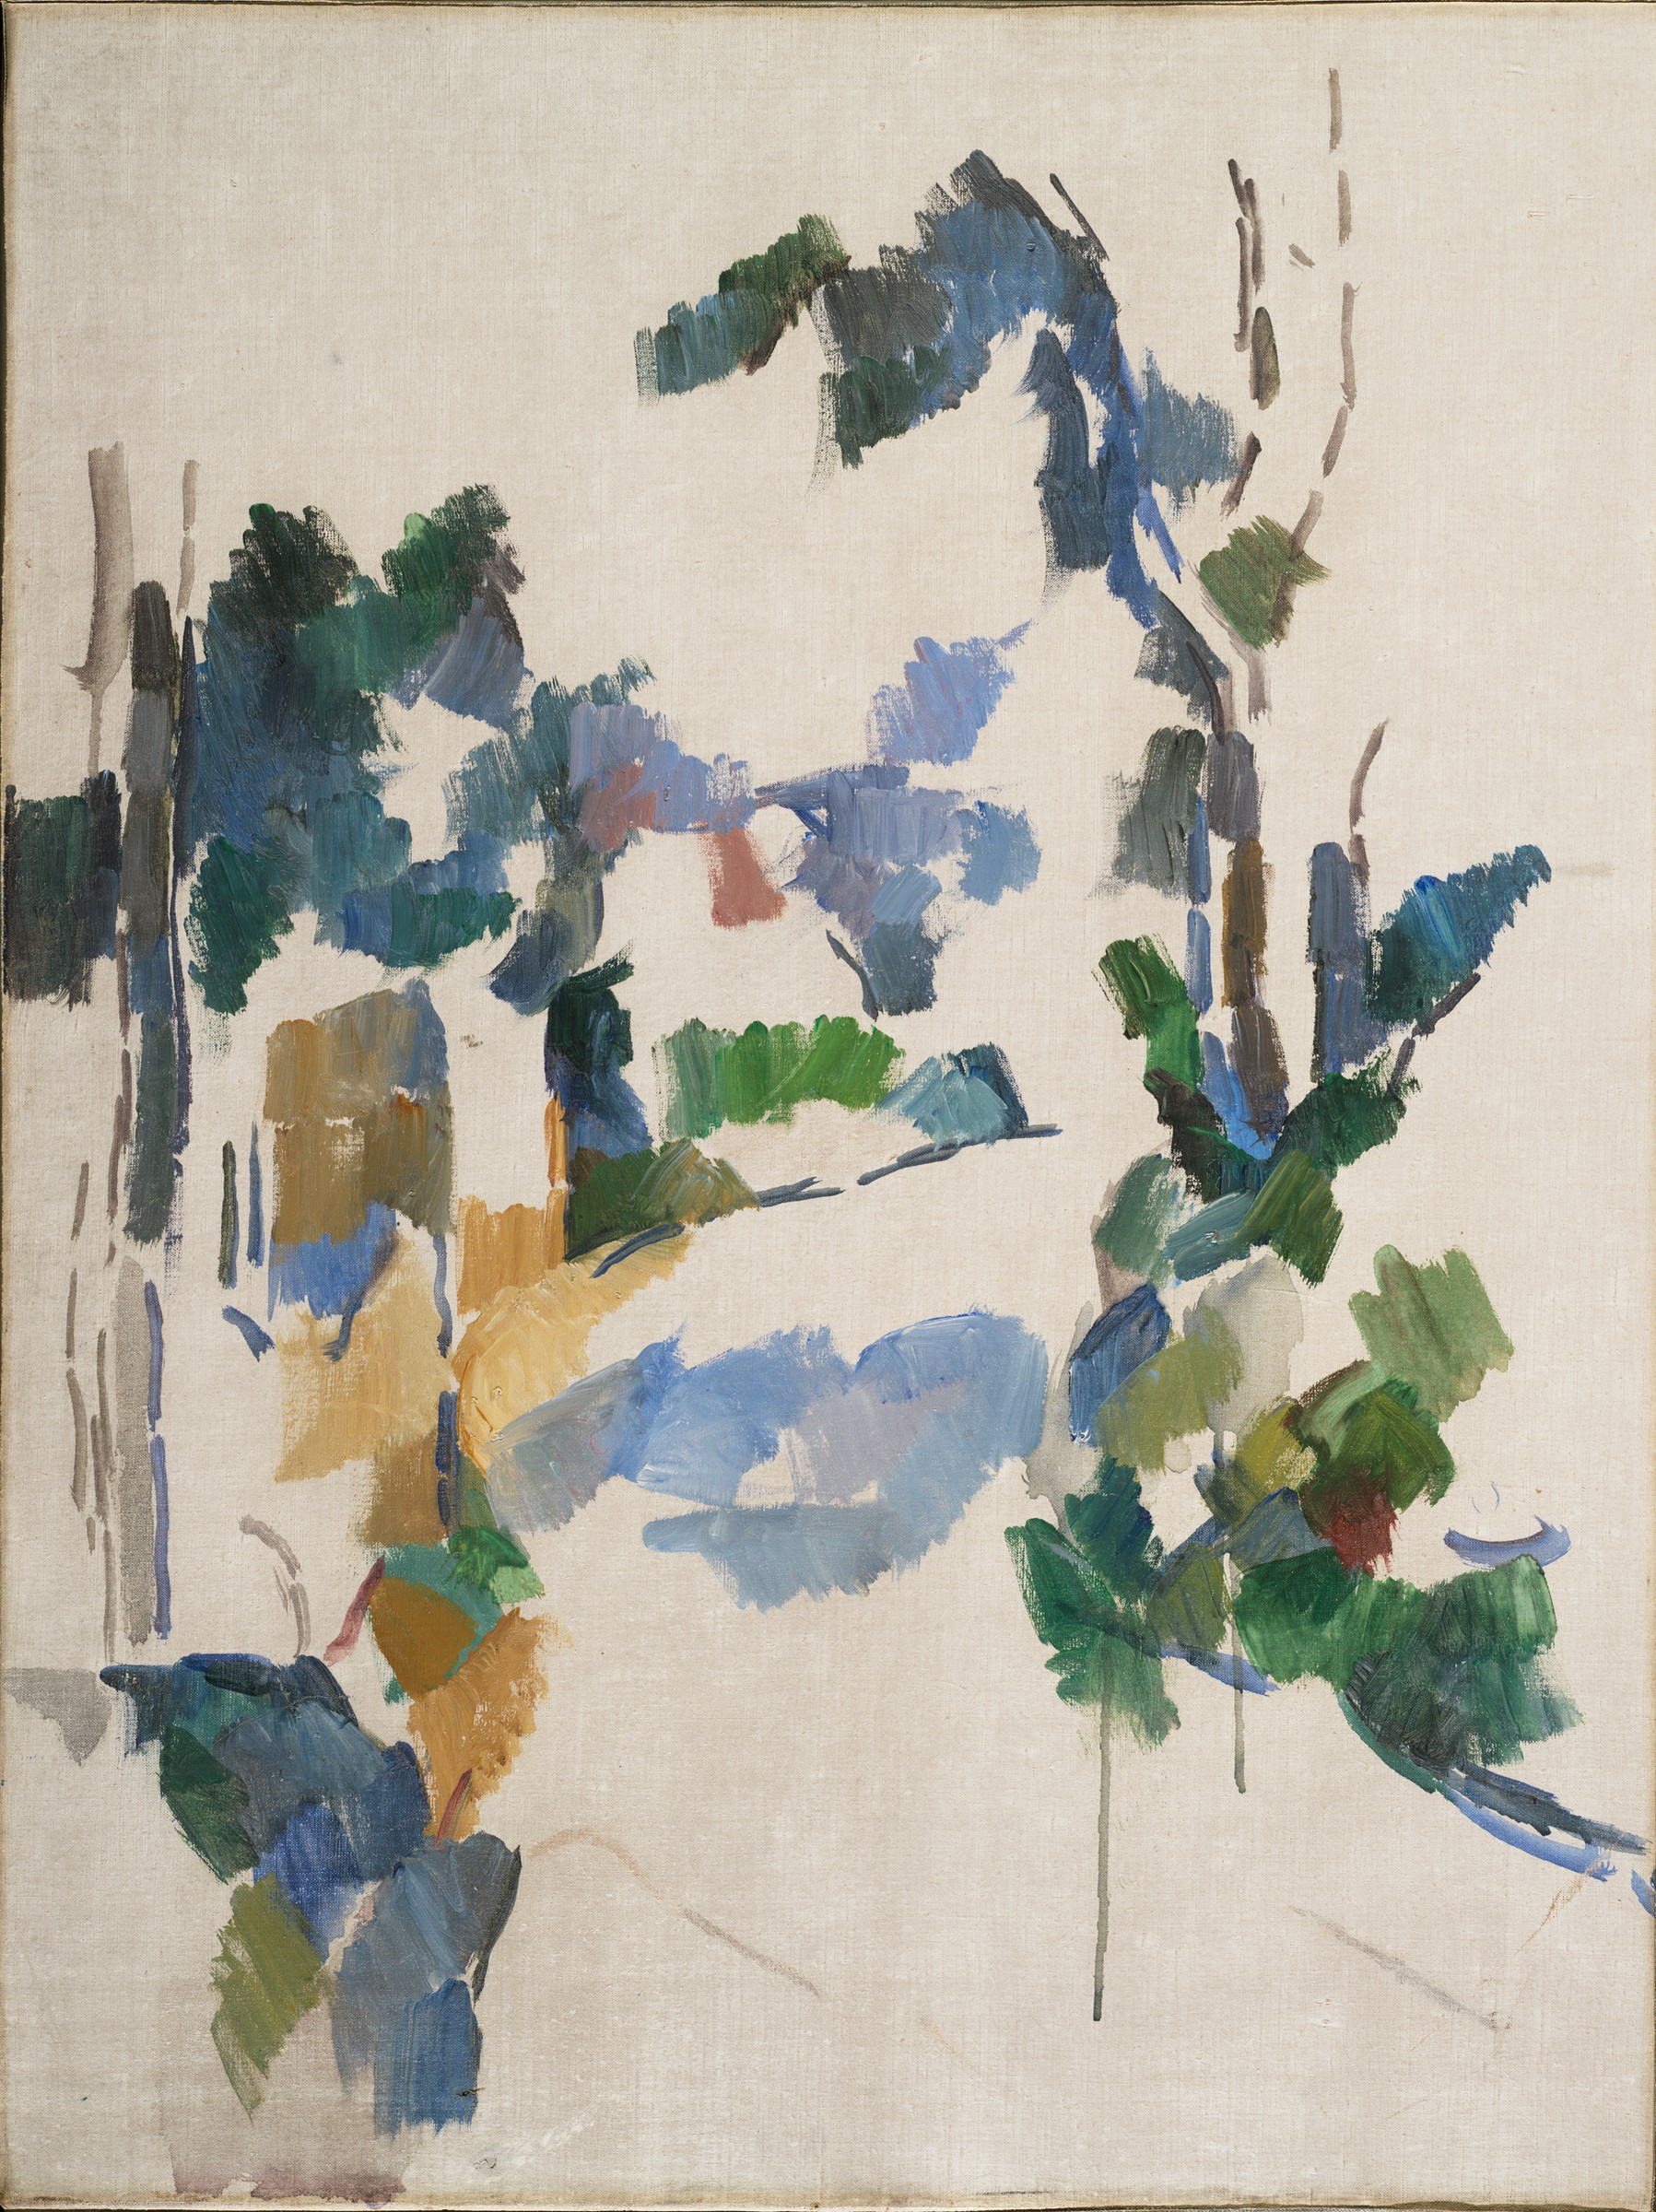
Demo 2
girl in a red dress
study of trees

Slide 17

Discussion
Problems Encountered/Drawbacks
- accessing full breadth of API
- verbatim titles
- “Untitled”, parenthesized, alternative titles
- null answers → rephrase system answer
- <forget-all>
- time out errors
- no social aspect
- sort image
- redundancy of each query
Capabilities
- resolve all queries of predicates in ontology
- accommodates null values in API
- handles pronouns
- over-answering
- ~ topic switch
- grounding to go back to menu

Slide 18
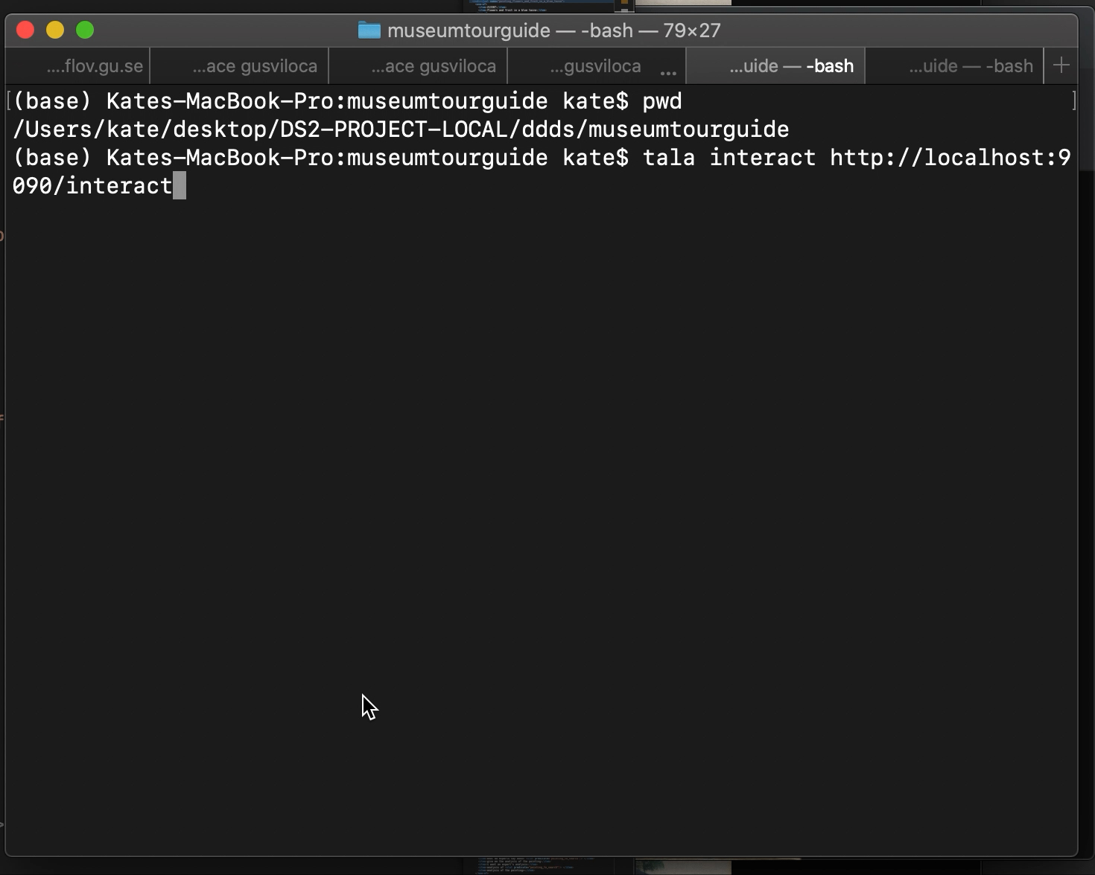

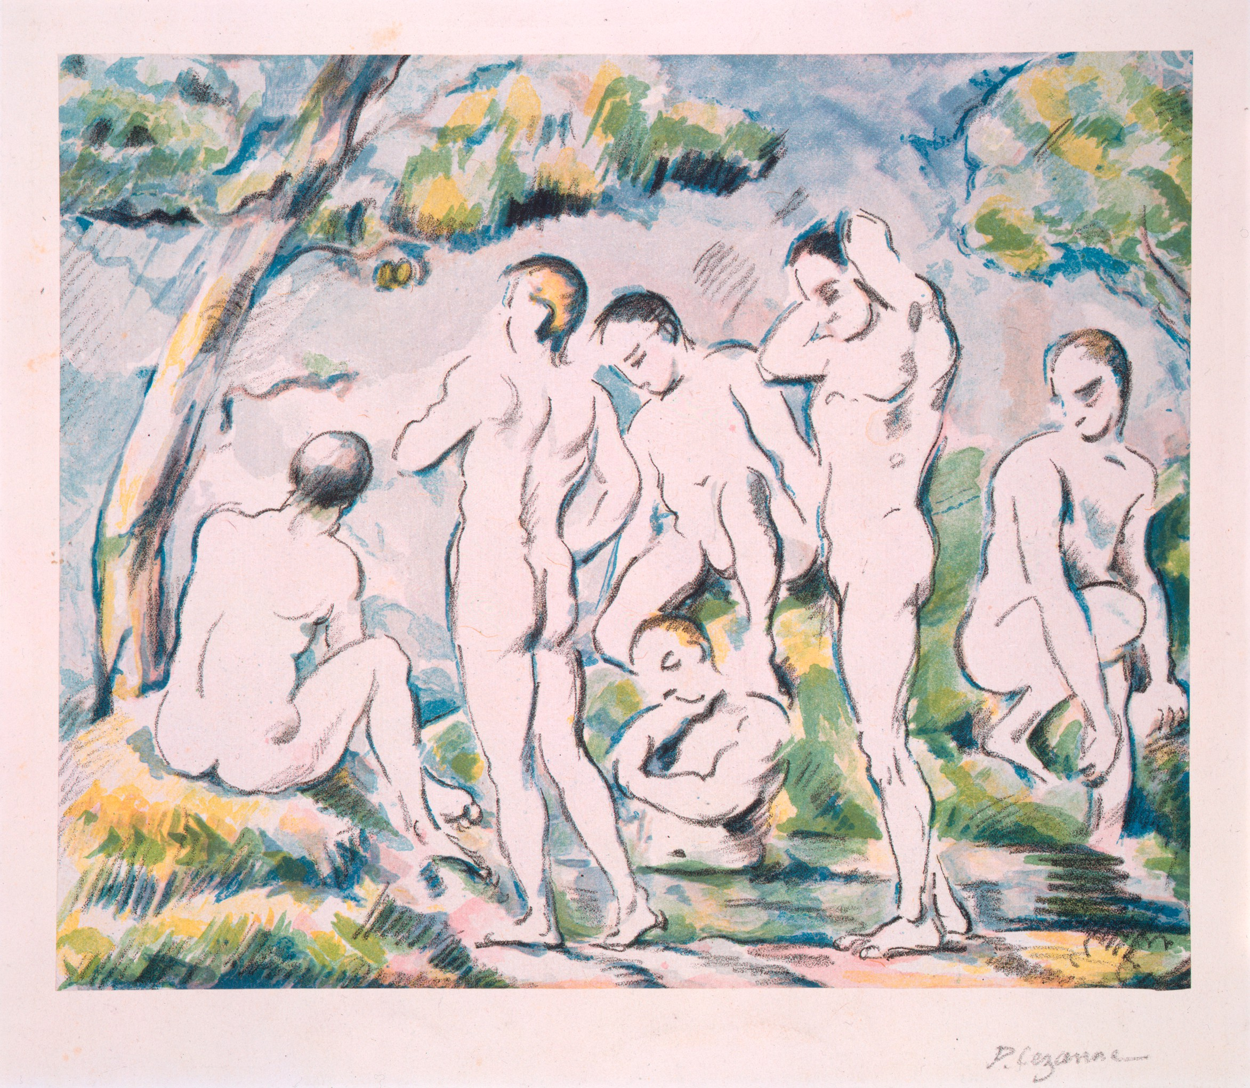
Demo 3
untitled (study for harvard murals) (recto and verso)
the small bathers

Slide 19

Future Work
System Improvements
- longer sessions before timeout error
- error messages OR better documentation for exceptions
- manually refresh okteto for updated http-service.py
Implementation
- full access to data available within API (i.e. artist page, all objects)
- query with two predicates for accuracy (incrementality)
- system answer with two predicates
- alternative system answers (null)
- sociable tour guide
- <postplan> (“Do you want to ask anything else about this painting”)
- NLG
- access to an exhibit

Slide 20
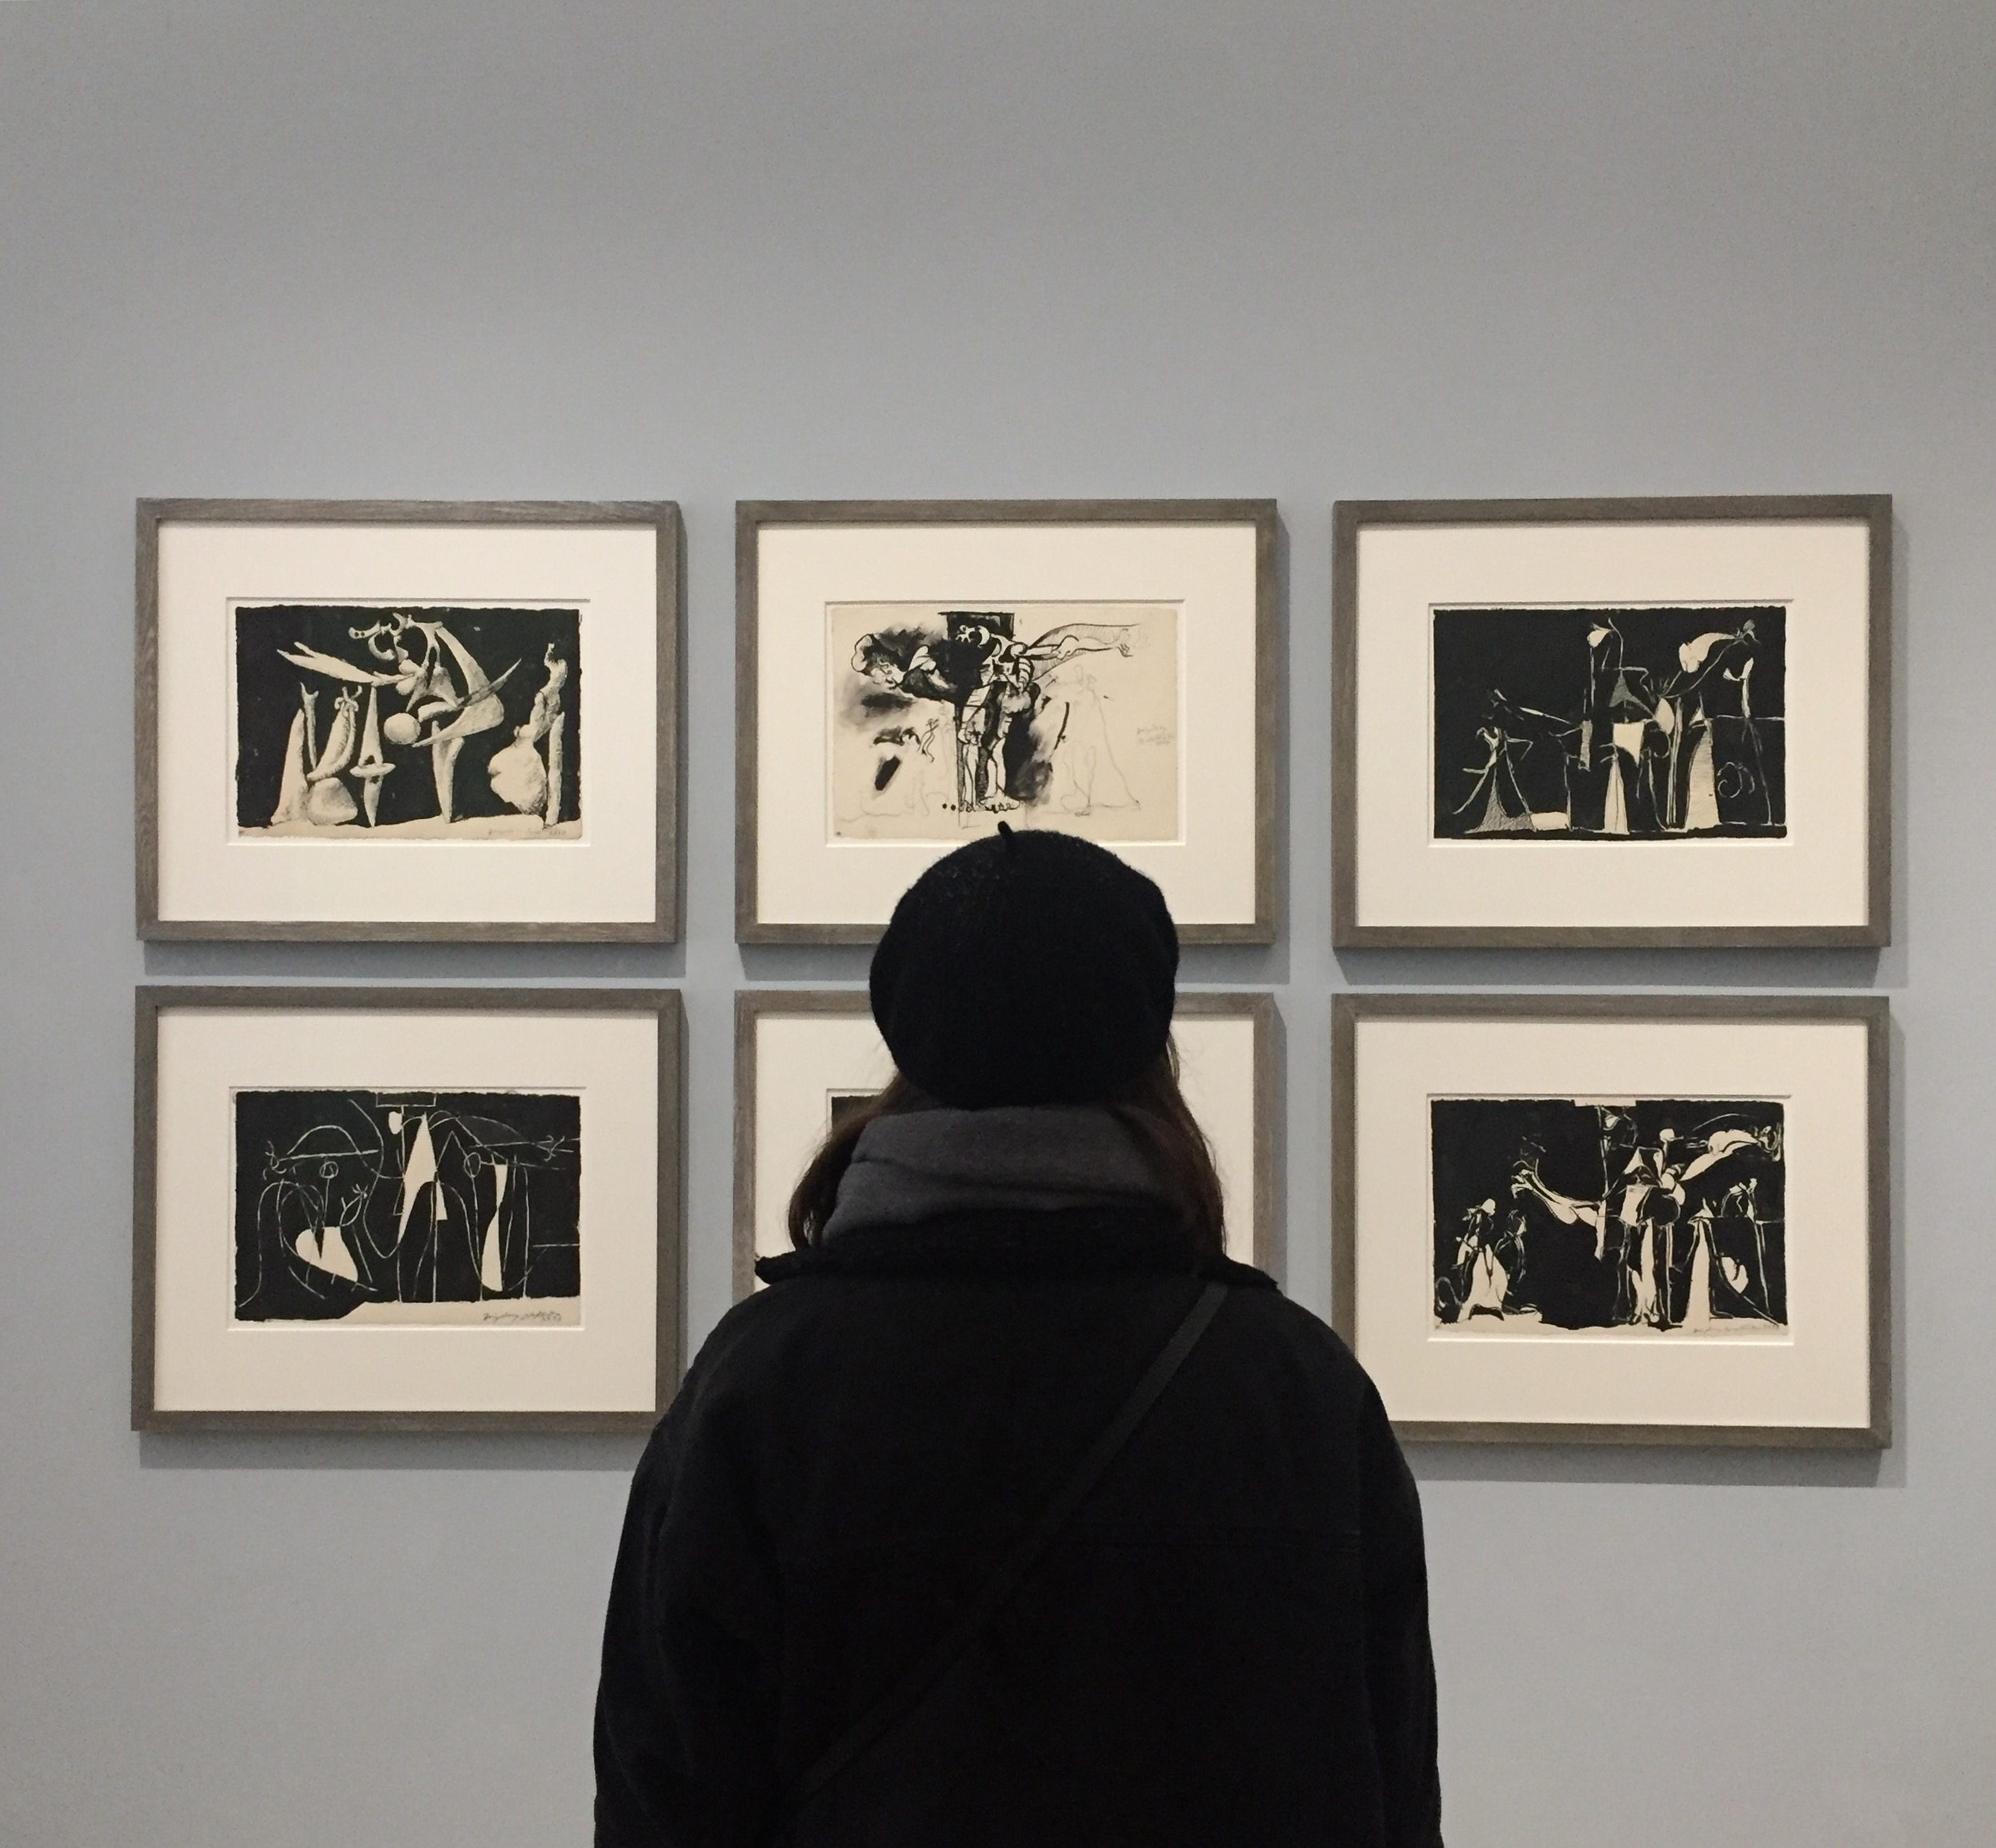
THANK YOU!

